Slide 1
Trees

Slide 2
Definition of Tree
A tree is a finite set of one or more nodes such that:
There is a specially designated node called the root.
The remaining nodes are partitioned into n>=0 disjoint sets T1, ..., Tn, where each of these sets is a tree.
We call T1, ..., Tn the subtrees of the root.

Slide 3
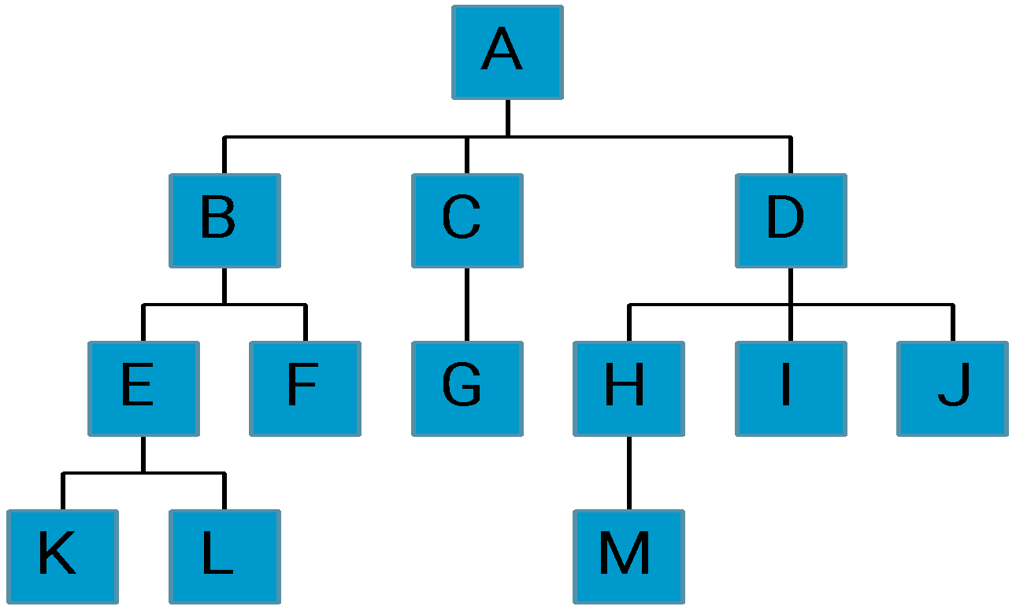
Level and Depth
Level
1
2
3
4
node (13)
degree of a node
leaf (terminal)
nonterminal
parent
children
sibling
degree of a tree (3)
ancestor
level of a node
height of a tree (4)
3
1
2
2
1
2
3
2
2
3
3
3
3
0
1
3
3
0
0
0
0
4
0
4
0
4

Slide 4
Terminology
The degree of a node is the number of subtrees of the node
The degree of A is 3; the degree of C is 1.
The node with degree 0 is a leaf or terminal node.
A node that has subtrees is the parent of the roots of the subtrees.
The roots of these subtrees are the children of the node.
Children of the same parent are siblings.
The ancestors of a node are all the nodes along the path from the root to the node.

Slide 5
Representation of Trees
List Representation
( A ( B ( E ( K, L ), F ), C ( G ), D ( H ( M ), I, J ) ) )
The root comes first, followed by a list of sub-trees
data
link 1
link 2
...
link n
How many link fields are
needed in such a representation?

Slide 6
Left Child - Right Sibling
data
A
left child
right sibling
B
C
D
E
F
G
H
I
J
K
L
M

Slide 7
Binary Trees
A binary tree is a finite set of nodes that is either empty or consists of a root and two disjoint binary trees called the left subtree and the right subtree.
Any tree can be transformed into binary tree.
by left child-right sibling representation
The left subtree and the right subtree are distinguished.

Slide 8
*Figure 5.6: Left child-right child tree representation of a tree
A
B
E
C
G
D
K
F
H
L
M
I
J

Slide 9
Abstract Data Type Binary_Tree
structure Binary_Tree(abbreviated BinTree) is
objects: a finite set of nodes either empty or consisting of a root node, left Binary_Tree, and right Binary_Tree.
functions:
for all bt, bt1, bt2 ∈ BinTree, item ∈ element
Bintree Create()::= creates an empty binary tree
Boolean IsEmpty(bt)::= if (bt==empty binary tree) return TRUE else return FALSE

Slide 10
BinTree MakeBT(bt1, item, bt2)::= return a binary tree
whose left subtree is bt1, whose right subtree is bt2,
and whose root node contains the data item
Bintree Lchild(bt)::= if (IsEmpty(bt)) return error else return the left subtree of bt
element Data(bt)::= if (IsEmpty(bt)) return error else return the data in the root node of bt
Bintree Rchild(bt)::= if (IsEmpty(bt)) return error else return the right subtree of bt

Slide 11
Samples of Trees
Complete Binary Tree
A
A
1
A
B
B
2
B
C
C
Skewed Binary Tree
3
D
E
F
G
D
4
H
I
E
5

Slide 12
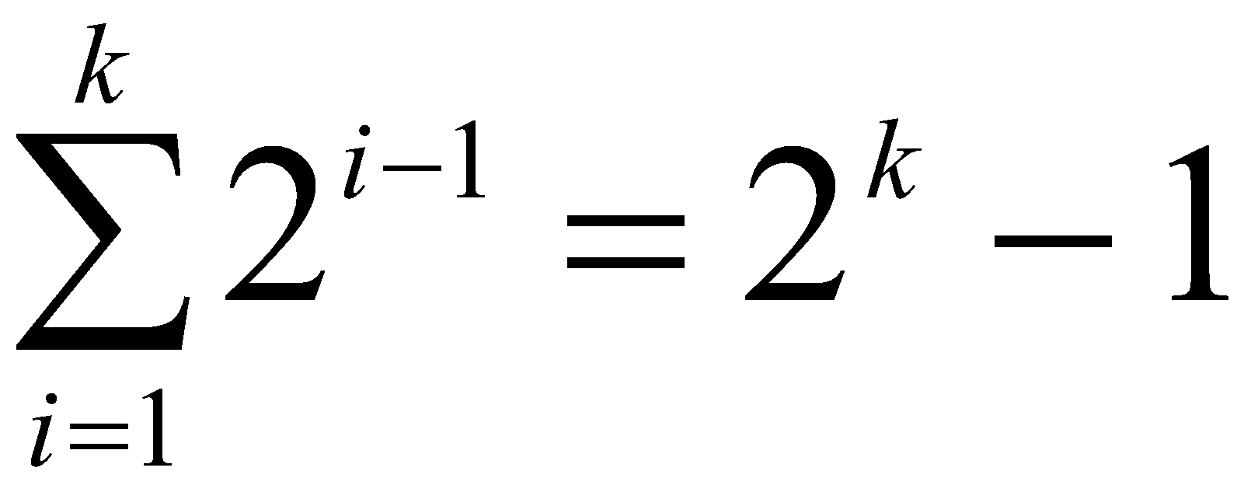
Maximum Number of Nodes in BT
The maximum number of nodes on level i of a binary tree is 2^{i-1}, i>=1.
The maximum nubmer of nodes in a binary tree of depth k is 2^{k}-1, k>=1.
i-1
Prove by induction.

Slide 13
Relations between Number of Leaf Nodes and Nodes of Degree 2
For any nonempty binary tree, T, if n0 is the number of leaf nodes and n2 the number of nodes of degree 2, then n0=n2+1
proof:
Let n and B denote the total number of nodes &
branches in T.
Let n0, n1, n2 represent the nodes with no children,
single child, and two children respectively.
n= n0+n1+n2, B+1=n, B=n1+2n2 ==> n1+2n2+1= n,
n1+2n2+1= n0+n1+n2 ==> n0=n2+1

Slide 14
Full BT VS Complete BT
A full binary tree of depth k is a binary tree of depth k having 2 -1 nodes, k>=0.
A binary tree with n nodes and depth k is complete iff its nodes correspond to the nodes numbered from 1 to n in the full binary tree of depth k.
k
A
A
B
C
B
C
D
E
F
G
D
E
F
G
H
H
I
J
K
L
M
N
O
I
Complete binary tree
Full binary tree of depth 4

Slide 15
Binary Tree Representations
If a complete binary tree with n nodes (depth = log n + 1) is represented sequentially, then for any node with index i, 1<=i<=n, we have:
parent(i) is at i/2 if i!=1. If i=1, i is at the root and has no parent.
left_child(i) ia at 2i if 2i<=n. If 2i>n, then i has no left child.
right_child(i) ia at 2i+1 if 2i +1 <=n. If 2i +1 >n, then i has no right child.

Slide 16
Sequential Representation
[1]
[2]
[3]
[4]
[5]
[6]
[7]
[8]
[9]
A
B
C
D
E
F
G
H
I
(1) waste space
(2) insertion/deletion
problem
A
[1]
[2]
[3]
[4]
[5]
[6]
[7]
[8]
[9]
.
[16]
A
B
--
C
--
--
--
D
--
.
E
B
A
C
B
C
D
D
E
F
G
E
H
I

Slide 17
Linked Representation
typedef struct node *tree_pointer;
typedef struct node {
int data;
tree_pointer left_child, right_child;
};
data
left_child
data
right_child
left_child
right_child

Slide 18
Binary Tree Abstract Data Type
ADT btree
1. Declare create() -->btree
2. makebtree(btree, element, btree) -->btree
3. isEmpty(btree) -->boolean
4. leftchild(btree) -->btree
5. rightchild(btree) -->btree
6. data(btree) -->element
7. for all l,r belongs to btree, e belongs to element, Let
8. isEmpty(create) = true
9. isEmpty(makebtree(l,e,r)) = false
10. leftchild(create()) = error
11. rightchild(create()) = error
12. leftchild(makebtree(l,e,r)) = l
13. rightchild(makebtree(l,e,r)) = r
14. data(makebtree(l,e,r)) = e
15. end
end btree

Slide 19
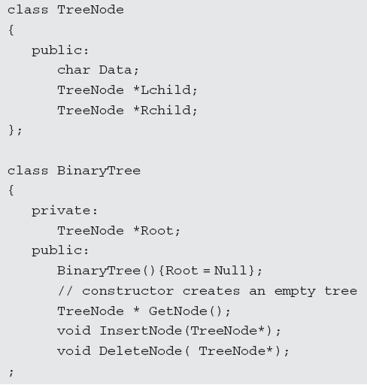
Program

Slide 20
Operations on binary tree
1. Creation—Creating an empty binary tree to which the ‘root’ points
2. Traversal—Visiting all the nodes in a binary tree
3. Deletion—Deleting a node from a non-empty binary tree
4.Insertion—Inserting a node into an existing (may be empty) binary tree
5. Merge—Merging two binary trees
6. Copy—Copying a binary tree
7. Compare—Comparing two binary trees
8. Finding a replica or mirror of a binary tree

Slide 21
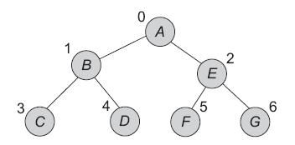

Realization of A Binary Tree
Array Implementation of Binary Trees :

Slide 22
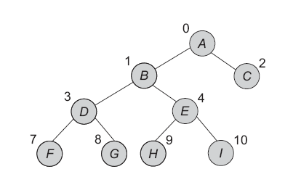
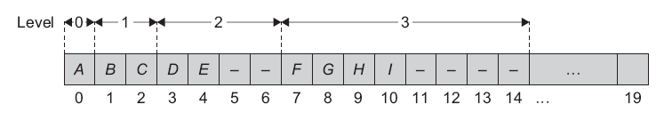

Slide 23
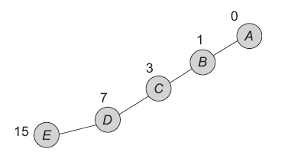


Slide 24
Advantages
Any node can be accessed from any other node by calculating the index.
Here, the data is stored without any pointers to its successor or predecessor.
In the programming languages, where dynamic memory allocation is not possible(such as BASIC, fortran ), array representation is the only means to store a tree.

Slide 25
Disadvantages
Other than full binary trees, majority of the array entries may be empty.
It allows only static representation. The array size cannot be changed during the execution.
Inserting a new node to it or deleting a node from it is inefficient with this representation, because it requires considerable data movement up and down the array, which demand excessive amount of processing time.

Slide 26
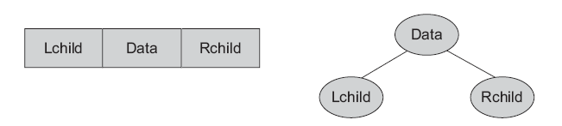
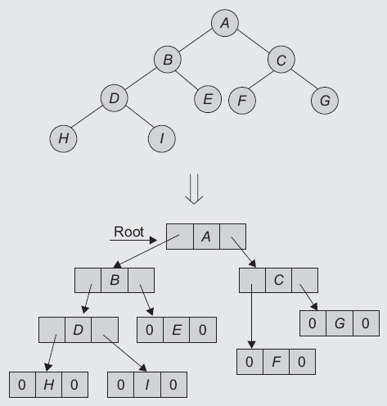
Linked Implementation of Binary Trees

Slide 27
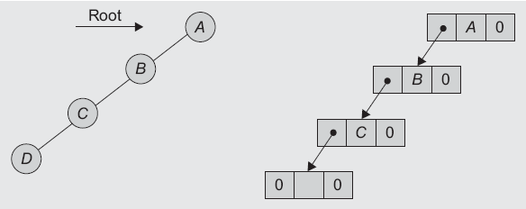

Slide 28
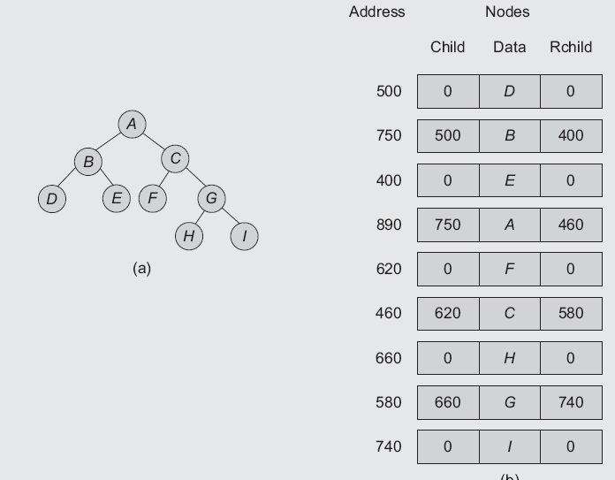
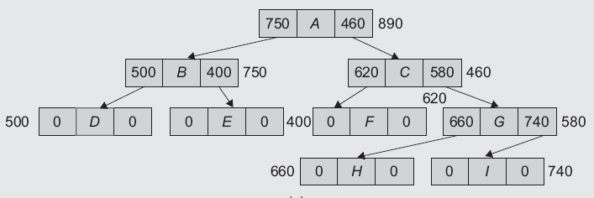

Slide 29
Advantages
The drawbacks of the sequential representation are overcome in this representation. We may or may not know the tree depth in advance. In addition, for unbalanced trees, the memory is not wasted.
Insertion and deletion operations are more efficient in this representation.
It is useful for dynamic data.

Slide 30
Disadvantages
In this representation, there is no direct access to any node. It has to be traversed from the root to reach to a particular node.
As compared to sequential representation, the memory needed per node is more. This is due to two link fields (left child and right child for binary trees) in the node.
The programming languages not supporting dynamic memory management would not be useful for this representation.

Slide 31
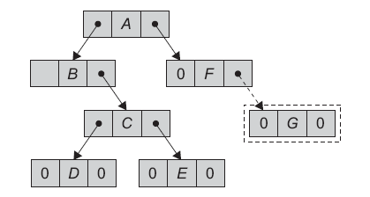
Insertion of a node in Binary tree

Slide 32
Binary Tree Traversals
Let L, V, and R stand for moving left, visiting the node, and moving right.
There are six possible combinations of traversal
LVR, LRV, VLR, VRL, RVL, RLV
Adopt convention that we traverse left before right, only 3 traversals remain
LVR, LRV, VLR
inorder, postorder, preorder

Slide 33
Arithmetic Expression Using BT
+
inorder traversal
A / B * C * D + E
infix expression
preorder traversal
+ * * / A B C D E
prefix expression
postorder traversal
A B / C * D * E +
postfix expression
level order traversal
+ * E * D / C A B
*
E
*
D
/
C
A
B

Slide 34
Inorder Traversal (recursive version)
void inorder(tree_pointer ptr)
/* inorder tree traversal */
{
if (ptr) {
inorder(ptr->left_child);
printf(“%d”, ptr->data);
indorder(ptr->right_child);
}
}
A / B * C * D + E

Slide 35
Preorder Traversal (recursive version)
void preorder(tree_pointer ptr)
/* preorder tree traversal */
{
if (ptr) {
printf(“%d”, ptr->data);
preorder(ptr->left_child);
predorder(ptr->right_child);
}
}
+ * * / A B C D E

Slide 36
Postorder Traversal (recursive version)
void postorder(tree_pointer ptr)
/* postorder tree traversal */
{
if (ptr) {
postorder(ptr->left_child);
postdorder(ptr->right_child);
printf(“%d”, ptr->data);
}
}
A B / C * D * E +

Slide 37
Iterative Inorder Traversal (using stack)
void iter_inorder(tree_pointer node)
{
int top= -1; /* initialize stack */
tree_pointer stack[MAX_STACK_SIZE];
for (;;) {
for (; node; node=node->left_child)
add(&top, node);/* add to stack */
node= delete(&top);
/* delete from stack */
if (!node) break; /* empty stack */
printf(“%D”, node->data);
node = node->right_child;
}
}
O(n)

Slide 38
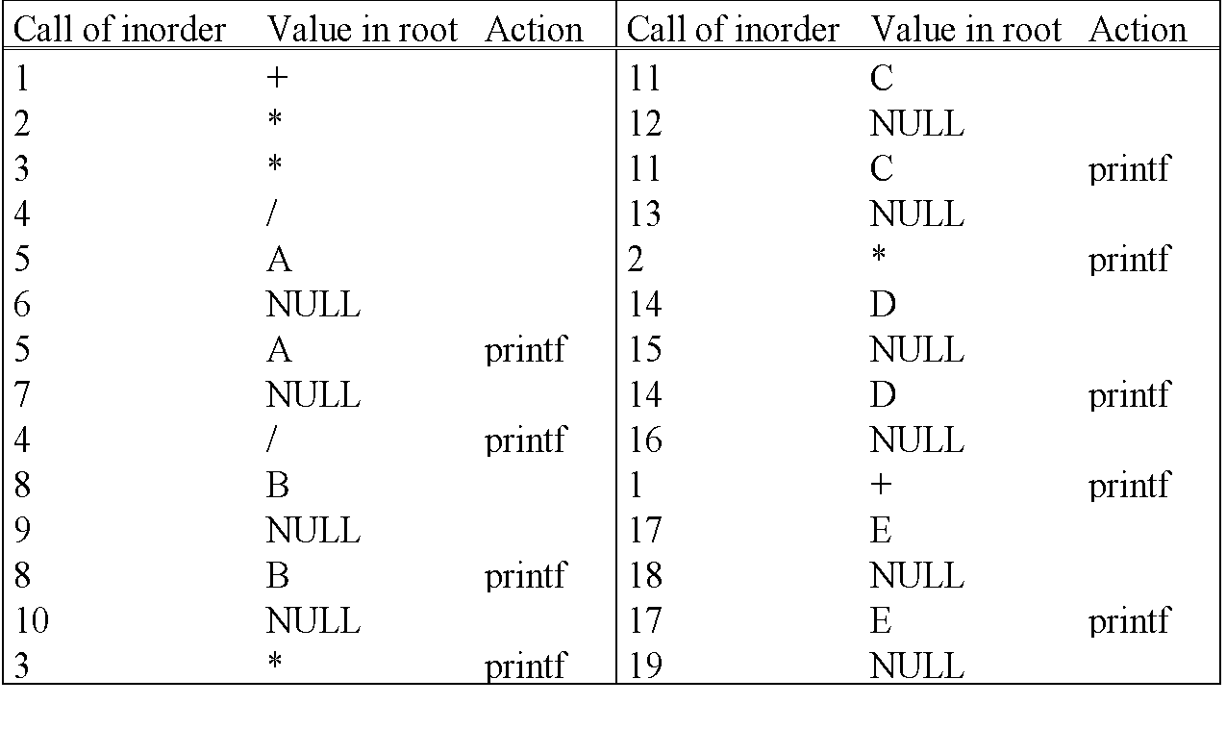
Trace Operations of Inorder Traversal

Slide 39
Level Order Traversal (using queue)
void level_order(tree_pointer ptr)
/* level order tree traversal */
{
int front = rear = 0;
tree_pointer queue[MAX_QUEUE_SIZE];
if (!ptr) return; /* empty queue */
addq(front, &rear, ptr);
for (;;) {
ptr = deleteq(&front, rear);

Slide 40
if (ptr) {
printf(“%d”, ptr->data);
if (ptr->left_child)
addq(front, &rear,
ptr->left_child);
if (ptr->right_child)
addq(front, &rear,
ptr->right_child);
}
else break;
}
}
+ * E * D / C A B

Slide 41
Copying Binary Trees
tree_poointer copy(tree_pointer original)
{
tree_pointer temp;
if (original) {
temp=(tree_pointer) malloc(sizeof(node));
if (IS_FULL(temp)) {
fprintf(stderr, “the memory is full\n”);
exit(1);
}
temp->left_child=copy(original->left_child);
temp->right_child=copy(original->right_child);
temp->data=original->data;
return temp;
}
return NULL;
}
postorder

Slide 42
Equality of Binary Trees
the same topology and data
int equal(tree_pointer first, tree_pointer second)
{
/* function returns FALSE if the binary trees first and
second are not equal, otherwise it returns TRUE */
return ((!first && !second) || (first && second &&
(first->data == second->data) &&
equal(first->left_child, second->left_child) &&
equal(first->right_child, second->right_child)))
}

Slide 43
Propositional Calculus Expression
A variable is an expression.
If x and y are expressions, then ¬x, x∧y, x∨y are expressions.
Parentheses can be used to alter the normal order of evaluation (¬ > ∧ > ∨).
Example: x₁ ∨ (x₂ ∧ ¬x₃)
satisfiability problem: Is there an assignment to make an expression true?

Slide 44
(x₁ ∧ ¬x₂) ∨ (¬ x₁ ∧ x₃) ∨ ¬x₃
(t,t,t)
(t,t,f)
(t,f,t)
(t,f,f)
(f,t,t)
(f,t,f)
(f,f,t)
(f,f,f)
2^{n} possible combinations
for n variables
∨
∨
¬
∧
∧
X₃
X₁
¬
¬
X₃
X₂
X₁
postorder traversal (postfix evaluation)

Slide 45
node structure
left_child data value right_child
typedef emun {not, and, or, true, false } logical; typedef struct node *tree_pointer; typedef struct node { tree_pointer list_child; logical data; short int value; tree_pointer right_child; } ;

Slide 46
for (all 2^{n} possible combinations) { generate the next combination; replace the variables by their values; evaluate root by traversing it in postorder; if (root->value) { printf(<combination>); return; } } printf(“No satisfiable combination \n”);
First version of satisfiability algorithm

Slide 47
void post_order_eval(tree_pointer node) { /* modified post order traversal to evaluate a propositional calculus tree */ if (node) { post_order_eval(node->left_child); post_order_eval(node->right_child); switch(node->data) { case not: node->value = !node->right_child->value; break;
Post-order-eval function

Slide 48
case and: node->value = node->right_child->value && node->left_child->value; break; case or: node->value = node->right_child->value | | node->left_child->value; break; case true: node->value = TRUE; break; case false: node->value = FALSE; } } }

Slide 49
Threaded Binary Trees
Two many null pointers in current representation of binary trees n: number of nodes number of non-null links: n-1 total links: 2n null links: 2n-(n-1)=n+1
Replace these null pointers with some useful “threads”.

Slide 50
Threaded Binary Trees (Continued)
If ptr->left_child is null,
replace it with a pointer to the node that would be
visited before ptr in an inorder traversal
If ptr->right_child is null,
replace it with a pointer to the node that would be
visited after ptr in an inorder traversal

Slide 51
A Threaded Binary Tree
root
A
dangling
B
C
dangling
D
E
F
G
inorder traversal:
H, D, I, B, E, A, F, C, G
H
I

Slide 52
Data Structures for Threaded BT
left_thread left_child data right_child right_thread
TRUE
●
●
FALSE
TRUE: thread
FALSE: child
typedef struct threaded_tree *threaded_pointer;
typedef struct threaded_tree {
short int left_thread;
threaded_pointer left_child;
char data;
threaded_pointer right_child;
short int right_thread; };

Slide 53
Memory Representation of A Threaded BT
root
--
f
f
f
A
f
f
B
f
f
C
f
f
D
f
t
E
t
t
F
t
t
G
t
t
H
t
t
I
t

Slide 54
Next Node in Threaded BT
threaded_pointer insucc(threaded_pointer tree)
{
threaded_pointer temp;
temp = tree->right_child;
if (!tree->right_thread)
while (!temp->left_thread)
temp = temp->left_child;
return temp;
}

Slide 55
Inorder Traversal of Threaded BT
void tinorder(threaded_pointer tree)
{
/* traverse the threaded binary tree inorder */
threaded_pointer temp = tree;
for (;;) {
temp = insucc(temp);
if (temp==tree) break;
printf(“%3c”, temp->data);
}
}
O(n)

Slide 56
Inserting Nodes into Threaded BTs
Insert child as the right child of node parent
change parent->right_thread to FALSE
set child->left_thread and child->right_thread to TRUE
set child->left_child to point to parent
set child->right_child to parent->right_child
change parent->right_child to point to child

Slide 57
Examples
Insert a node D as a right child of B.
root
root
A
A
(1)
B
parent
B
parent
(3)
child
child
C
D
C
D
(2)
empty

Slide 58
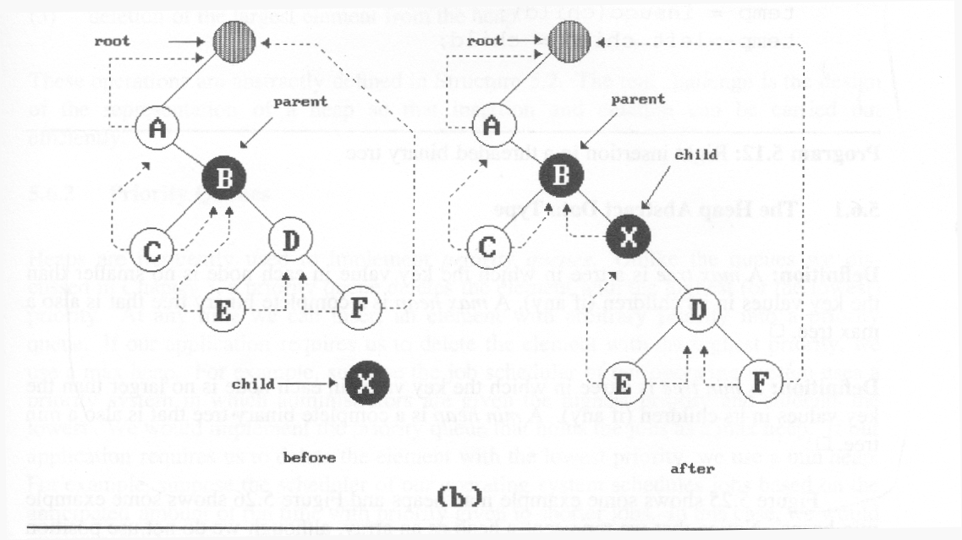
*Figure 5.24: Insertion of child as a right child of parent in a threaded binary tree (p.217)
(3)
(2)
(1)
(4)
nonempty

Slide 59
Right Insertion in Threaded BTs
void insert_right(threaded_pointer parent,
threaded_pointer child)
{
threaded_pointer temp;
child->right_child = parent->right_child;
child->right_thread = parent->right_thread;
child->left_child = parent; case (a)
child->left_thread = TRUE;
parent->right_child = child;
parent->right_thread = FALSE;
if (!child->right_thread) { case (b) temp = insucc(child);
temp->left_child = child;
}
}
(1)
(2)
(3)
(4)

Slide 60
Huffman Coding: An Application of Binary Trees

Slide 61
Encoding and Compression of Data
Fax Machines
ASCII
Variations on ASCII
min number of bits needed
cost of savings
patterns
modifications

Slide 62
Purpose of Huffman Coding
Proposed by Dr. David A. Huffman in 1952
“A Method for the Construction of Minimum Redundancy Codes”
Applicable to many forms of data transmission
Our example: text files

Slide 63
The Basic Algorithm
Huffman coding is a form of statistical coding
Not all characters occur with the same frequency!
Yet all characters are allocated the same amount of space
1 char = 1 byte, be it e or x

Slide 64
The Basic Algorithm
Any savings in tailoring codes to frequency of character?
Code word lengths are no longer fixed like ASCII.
Code word lengths vary and will be shorter for the more frequently used characters.

Slide 65
The (Real) Basic Algorithm
1. Scan text to be compressed and tally occurrence of all characters.
2. Sort or prioritize characters based on number of occurrences in text.
3. Build Huffman code tree based on prioritized list.
4. Perform a traversal of tree to determine all code words.
5. Scan text again and create new file using the Huffman codes.

Slide 66
Building a Tree Scan the original text
Consider the following short text:
Eerie eyes seen near lake.
Count up the occurrences of all characters in the text

Slide 67
Building a Tree Scan the original text
Eerie eyes seen near lake.
What characters are present?
E e r i space
y s n a r l k .

Slide 68
Building a Tree Scan the original text
Eerie eyes seen near lake.
What is the frequency of each character in the text?

Slide 69
Building a Tree Prioritize characters
Create binary tree nodes with character and frequency of each character
Place nodes in a priority queue
The lower the occurrence, the higher the priority in the queue

Slide 70
Building a Tree Prioritize characters
Uses binary tree nodes
public class HuffNode
{
public char myChar;
public int myFrequency;
public HuffNode myLeft, myRight;
}
priorityQueue myQueue;

Slide 71
Building a Tree
The queue after inserting all nodes
Null Pointers are not shown
E
1
i
1
y
1
l
1
k
1
.
1
r
2
s
2
n
2
a
2
sp
4
e
8

Slide 72
Building a Tree
While priority queue contains two or more nodes
Create new node
Dequeue node and make it left subtree
Dequeue next node and make it right subtree
Frequency of new node equals sum of frequency of left and right children
Enqueue new node back into queue

Slide 73
Building a Tree
E
1
i
1
y
1
l
1
k
1
.
1
r
2
s
2
n
2
a
2
sp
4
e
8

Slide 74
Building a Tree
y
1
l
1
k
1
.
1
r
2
s
2
n
2
a
2
sp
4
e
8
2
E
1
i
1

Slide 75
Building a Tree
y
1
l
1
k
1
.
1
r
2
s
2
n
2
a
2
2
sp
4
e
8
E
1
i
1

Slide 76
Building a Tree
k
1
.
1
r
2
s
2
n
2
a
2
2
sp
4
e
8
E
1
i
1
2
y
1
l
1

Slide 77
Building a Tree
k
1
.
1
r
2
s
2
n
2
a
2
2
2
sp
4
e
8
y
1
l
1
E
1
i
1

Slide 78
Building a Tree
r
2
s
2
n
2
a
2
2
2
sp
4
e
8
y
1
l
1
E
1
i
1
2
k
1
.
1

Slide 79
Building a Tree
r
2
s
2
n
2
a
2
2
2
sp
4
e
8
2
E
1
i
1
y
1
l
1
k
1
.
1

Slide 80
Building a Tree
n
2
a
2
2
sp
4
e
8
2
2
E
1
i
1
y
1
l
1
k
1
.
1
4
r
2
s
2

Slide 81
Building a Tree
n
2
a
2
2
sp
4
e
8
2
2
4
E
1
i
1
y
1
l
1
k
1
.
1
r
2
s
2

Slide 82
Building a Tree
2
4
e
8
2
2
sp
4
y
1
l
1
k
1
.
1
r
2
s
2
E
1
i
1
4
n
2
a
2

Slide 83
Building a Tree
2
4
4
e
8
2
2
sp
4
y
1
l
1
k
1
.
1
r
2
s
2
n
2
a
2
E
1
i
1

Slide 84
Building a Tree
4
4
e
8
2
sp
4
k
1
.
1
r
2
s
2
n
2
a
2
4
2
2
E
1
i
1
y
1
l
1

Slide 85
Building a Tree
2
4
4
4
sp
4
e
8
2
2
k
1
.
1
r
2
s
2
n
2
a
2
E
1
i
1
y
1
l
1

Slide 86
Building a Tree
4
4
4
e
8
2
2
r
2
s
2
n
2
a
2
E
1
i
1
y
1
l
1
6
2
sp
4
k
1
.
1

Slide 87
Building a Tree
4
4
4
6
e
8
2
sp
4
r
2
s
2
n
2
a
2
2
2
k
1
.
1
E
1
i
1
y
1
l
1
What is happening to the characters with a low number of occurrences?

Slide 88
Building a Tree
4
6
e
8
2
2
2
sp
4
E
1
i
1
y
1
l
1
k
1
.
1
8
4
4
r
2
s
2
n
2
a
2

Slide 89
Building a Tree
4
6
e
8
8
2
2
2
sp
4
4
4
E
1
i
1
y
1
l
1
k
1
.
1
r
2
s
2
n
2
a
2

Slide 90
Building a Tree
e
8
8
4
4
10
r
2
s
2
n
2
a
2
4
6
2
2
2
sp
4
E
1
i
1
y
1
l
1
k
1
.
1

Slide 91
Building a Tree
e
8
8
10
4
4
4
6
n
2
a
2
2
2
2
r
2
s
2
sp
4
E
1
i
1
y
1
l
1
k
1
.
1

Slide 92
Building a Tree
10
16
4
6
2
2
2
e
8
8
sp
4
E
1
i
1
y
1
l
1
k
1
.
1
4
4
r
2
s
2
n
2
a
2

Slide 93
Building a Tree
10
16
4
6
e
8
8
2
2
2
sp
4
4
4
E
1
i
1
y
1
l
1
k
1
.
1
r
2
s
2
n
2
a
2

Slide 94
Building a Tree
26
16
10
4
e
8
8
6
2
2
2
sp
4
4
4
E
1
i
1
y
1
l
1
k
1
.
1
r
2
s
2
n
2
a
2

Slide 95
Building a Tree
After enqueueing this node there is only one node left in priority queue.
26
16
10
4
e
8
8
6
2
2
2
sp
4
4
4
E
1
i
1
y
1
l
1
k
1
.
1
r
2
s
2
n
2
a
2

Slide 96
Building a Tree
Dequeue the single node left in the queue.
This tree contains the new code words for each character.
Frequency of root node should equal number of characters in text.
26
16
10
4
e
8
8
6
2
2
2
4
sp
4
4
E
1
i
1
y
1
l
1
k
1
.
1
r
2
s
2
n
2
a
2
Eerie eyes seen near lake.  26 characters

Slide 97
Encoding the File Traverse Tree for Codes
Perform a traversal of the tree to obtain new code words
Going left is a 0 going right is a 1
code word is only completed when a leaf node is reached
26
16
10
4
e
8
8
6
2
2
2
4
sp
4
4
E
1
i
1
y
1
l
1
k
1
.
1
r
2
s
2
n
2
a
2

Slide 98
Encoding the File Traverse Tree for Codes
Char Code
E 0000
i 0001
y 0010
l 0011
k 0100
. 0101
space 011
e 10
r 1100
s 1101
n 1110
a 1111
26
16
10
4
e
8
8
6
2
2
2
4
sp
4
4
E
1
i
1
y
1
l
1
k
1
.
1
r
2
s
2
n
2
a
2

Slide 99
Encoding the File
Rescan text and encode file using new code words
Eerie eyes seen near lake.
Char Code
E 0000
i 0001
y 0010
l 0011
k 0100
. 0101
space 011
e 10
r 1100
s 1101
n 1110
a 1111
0000101100000110011100010101101101001111101011111100011001111110100100101
Why is there no need for a separator character?
.

Slide 100
Encoding the File Results
Have we made things any better?
73 bits to encode the text
ASCII would take 8 * 26 = 208 bits
0000101100000110011100010101101101001111101011111100011001111110100100101
If modified code used 4 bits per
character are needed. Total bits
4 * 26 = 104. Savings not as great.

Slide 101
Decoding the File
How does receiver know what the codes are?
Tree constructed for each text file.
Considers frequency for each file
Big hit on compression, especially for smaller files
Tree predetermined
based on statistical analysis of text files or file types
Data transmission is bit based versus byte based

Slide 102
Decoding the File
Once receiver has tree it scans incoming bit stream
0 ⇒ go left
1 ⇒ go right
26
16
10
4
e
8
8
6
2
2
2
4
sp
4
4
10100011011110111101111110000110101
E
1
i
1
y
1
l
1
k
1
.
1
r
2
s
2
n
2
a
2

Slide 103
Prefix code
No prefix of a codeword is a codeword
Uniquely decodable
A | 00 | 1 | 00
B | 010 | 01 | 10
C | 011 | 001 | 11
D | 100 | 0001 | 0001
E | 11 | 00001 | 11000
F | 101 | 000001 | 101

Slide 104
Prefix codes and binary trees
Tree representation of prefix codes
A | 00
B | 010
C | 0110
D | 0111
E | 10
F | 11

Slide 105
Construct the tree for the following code
E | 0
T | 11
N | 100
I | 1010
S | 1011

Slide 106
Minimum length code
Average cost
Average leaf depth
Huffman tree – tree with minimum weighted path length
C(T) – weighted path length

Slide 107
Compute average leaf depth
A | 00 | 1/4
B | 010 | 1/8
C | 0110 | 1/16
D | 0111 | 1/16
E | 1 | 1/2

Slide 108



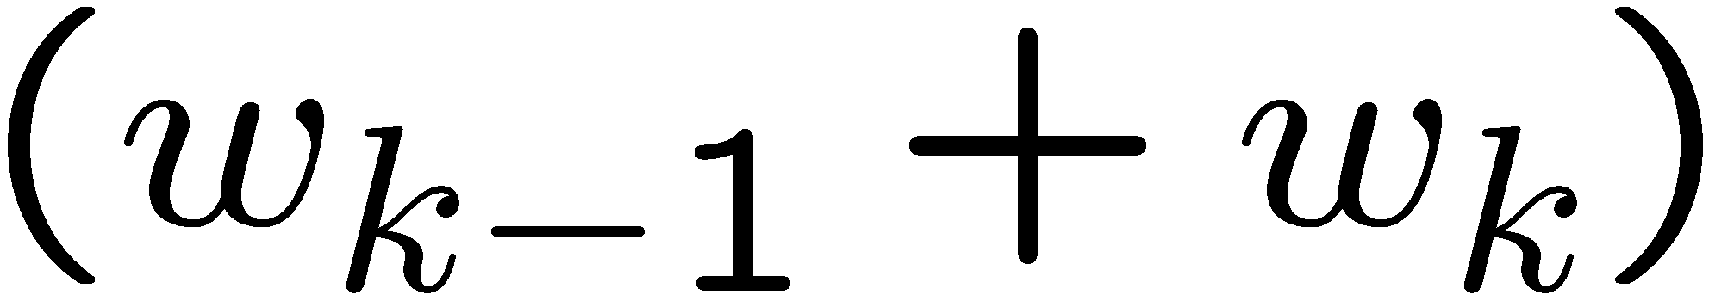
Huffman code algorithm
Derivation
Two rarest items will have the longest codewords
Codewords for rarest items differ only in the last bit
Idea: suppose the weights are with and the smallest weights
Start with an optimal code for and
Extend the codeword for to get codewords for and

Slide 109
Huffman code
H = new Heap()
for each w_{i}
T = new Tree(w_{i})
H.Insert(T)
while H.Size() > 1
T₁ = H.DeleteMin()
T₂ = H.DeleteMin()
T₃ = Merge(T₁, T₂)
H.Insert(T₃)

Slide 110
Example: Weights 4, 5, 6, 7, 11, 14, 21

Slide 111
Draw a Huffman tree for the following data values and show internal weights: 3, 5, 9, 14, 16, 35

Slide 112
Summary
Huffman coding is a technique used to compress files for transmission
Uses statistical coding
more frequently used symbols have shorter code words
Works well for text and fax transmissions
An application that uses several data structures

Slide 113
Heap
A max tree is a tree in which the key value in each node is no smaller than the key values in its children. A max heap is a complete binary tree that is also a max tree.
A min tree is a tree in which the key value in each node is no larger than the key values in its children. A min heap is a complete binary tree that is also a min tree.
Operations on heaps
creation of an empty heap
insertion of a new element into the heap;
deletion of the largest element from the heap

Slide 114
*Figure 5.25: Sample max heaps (p.219)
[1]
14
[1]
9
[1]
30
[2]
12
[3]
7
[2]
6
[3]
3
[2]
25
[4]
[5]
[6]
[4]
10
8
6
5
Property:
The root of max heap (min heap) contains
the largest (smallest).

Slide 115
*Figure 5.26:Sample min heaps (p.220)
[1]
2
[1]
10
[1]
11
[2]
7
[3]
4
[2]
20
[3]
83
[2]
21
[4]
[5]
[6]
[4]
10
8
6
50

Slide 116
ADT for Max Heap
structure MaxHeap
objects: a complete binary tree of n > 0 elements organized so that the value in each node is at least as large as those in its children
functions:
for all heap belong to MaxHeap, item belong to Element, n, max_size belong to integer
MaxHeap Create(max_size)::= create an empty heap that can hold a maximum of max_size elements
Boolean HeapFull(heap, n)::= if (n==max_size) return TRUE else return FALSE
MaxHeap Insert(heap, item, n)::= if (!HeapFull(heap,n)) insert item into heap and return the resulting heap else return error
Boolean HeapEmpty(heap, n)::= if (n>0) return FALSE
else return TRUE
Element Delete(heap,n)::= if (!HeapEmpty(heap,n)) return one instance of the largest element in the heap and remove it from the heap
else return error

Slide 117
Data Structures
unordered linked list
unordered array
sorted linked list
sorted array
heap

Slide 118
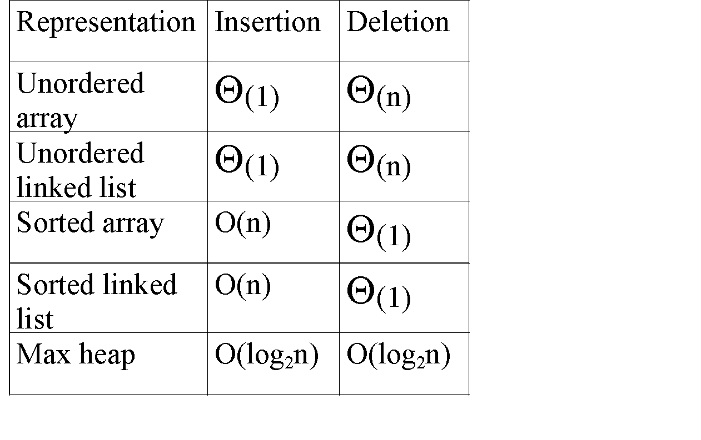
*Figure 5.27: Priority queue representations (p.221)

Slide 119
Example of Insertion to Max Heap
20
20
21
15
2
15
5
15
20
14
10
14
10
2
14
10
2
initial location of new node
insert 5 into heap
insert 21 into heap

Slide 120
Insertion into a Max Heap
void insert_max_heap(element item, int *n)
{
int i;
if (HEAP_FULL(*n)) {
fprintf(stderr, “the heap is full.\n”);
exit(1);
}
i = ++(*n);
while ((i!=1)&&(item.key>heap[i/2].key)) {
heap[i] = heap[i/2];
i /= 2;
}
heap[i]= item;
}
2^{k}-1=n ==> k=⎡log₂(n+1)⎤
O(log₂n)

Slide 121
Example of Deletion from Max Heap
remove
20
10
15
15
2
15
2
14
2
14
10
14
10

Slide 122
Deletion from a Max Heap
element delete_max_heap(int *n)
{
int parent, child;
element item, temp;
if (HEAP_EMPTY(*n)) {
fprintf(stderr, “The heap is empty\n”);
exit(1);
}
/* save value of the element with the highest key */
item = heap[1];
/* use last element in heap to adjust heap */
temp = heap[(*n)--];
parent = 1;
child = 2;

Slide 123
while (child <= *n) {
/* find the larger child of the current
parent */
if ((child < *n)&&
(heap[child].key<heap[child+1].key))
child++;
if (temp.key >= heap[child].key) break;
/* move to the next lower level */
heap[parent] = heap[child];
child *= 2;
}
heap[parent] = temp;
return item;
}

Slide 124
Binary Search Tree
Heap
a min (max) element is deleted. O(log₂n)
deletion of an arbitrary element O(n)
search for an arbitrary element O(n)
Binary search tree
Every element has a unique key.
The keys in a nonempty left subtree (right subtree) are smaller (larger) than the key in the root of subtree.
The left and right subtrees are also binary search trees.

Slide 125
Examples of Binary Search Trees
20
30
60
12
25
5
40
70
10
15
22
2
65
80

Slide 126
Searching a Binary Search Tree
tree_pointer search(tree_pointer root, int key)
{
/* return a pointer to the node that contains key. If there is no such node, return NULL */
if (!root) return NULL;
if (key == root->data) return root;
if (key < root->data)
return search(root->left_child,
key);
return search(root->right_child,key);
}

Slide 127
Another Searching Algorithm
tree_pointer search2(tree_pointer tree, int key)
{
while (tree) {
if (key == tree->data) return tree;
if (key < tree->data)
tree = tree->left_child;
else tree = tree->right_child;
}
return NULL;
}
O(h)

Slide 128
Insert Node in Binary Search Tree
30
30
30
40
5
40
5
40
5
2
80
2
35
80
2
Insert 80
Insert 35

Slide 129
Insertion into A Binary Search Tree
void insert_node(tree_pointer *node, int num)
{tree_pointer ptr,
temp = modified_search(*node, num);
if (temp || !(*node)) {
ptr = (tree_pointer) malloc(sizeof(node));
if (IS_FULL(ptr)) {
fprintf(stderr, “The memory is full\n”);
exit(1);
}
ptr->data = num;
ptr->left_child = ptr->right_child = NULL;
if (*node)
if (num<temp->data) temp->left_child=ptr;
else temp->right_child = ptr;
else *node = ptr;
}
}

Slide 130
Deletion for A Binary Search Tree
1
leaf
node
30
5
80
T2
T1
1
2
2
X
T1
T2

Slide 131
Deletion for A Binary Search Tree
non-leaf
node
40
40
20
60
20
55
10
30
50
70
10
30
50
70
45
55
45
52
52
Before deleting 60
After deleting 60

Slide 132
1
2
T1
T2
T3
1
2‘
T1
T2’
T3

